Slide 1


AEMR Outages
File created on: 10/8/2023 8:22:31 PM

Slide 2
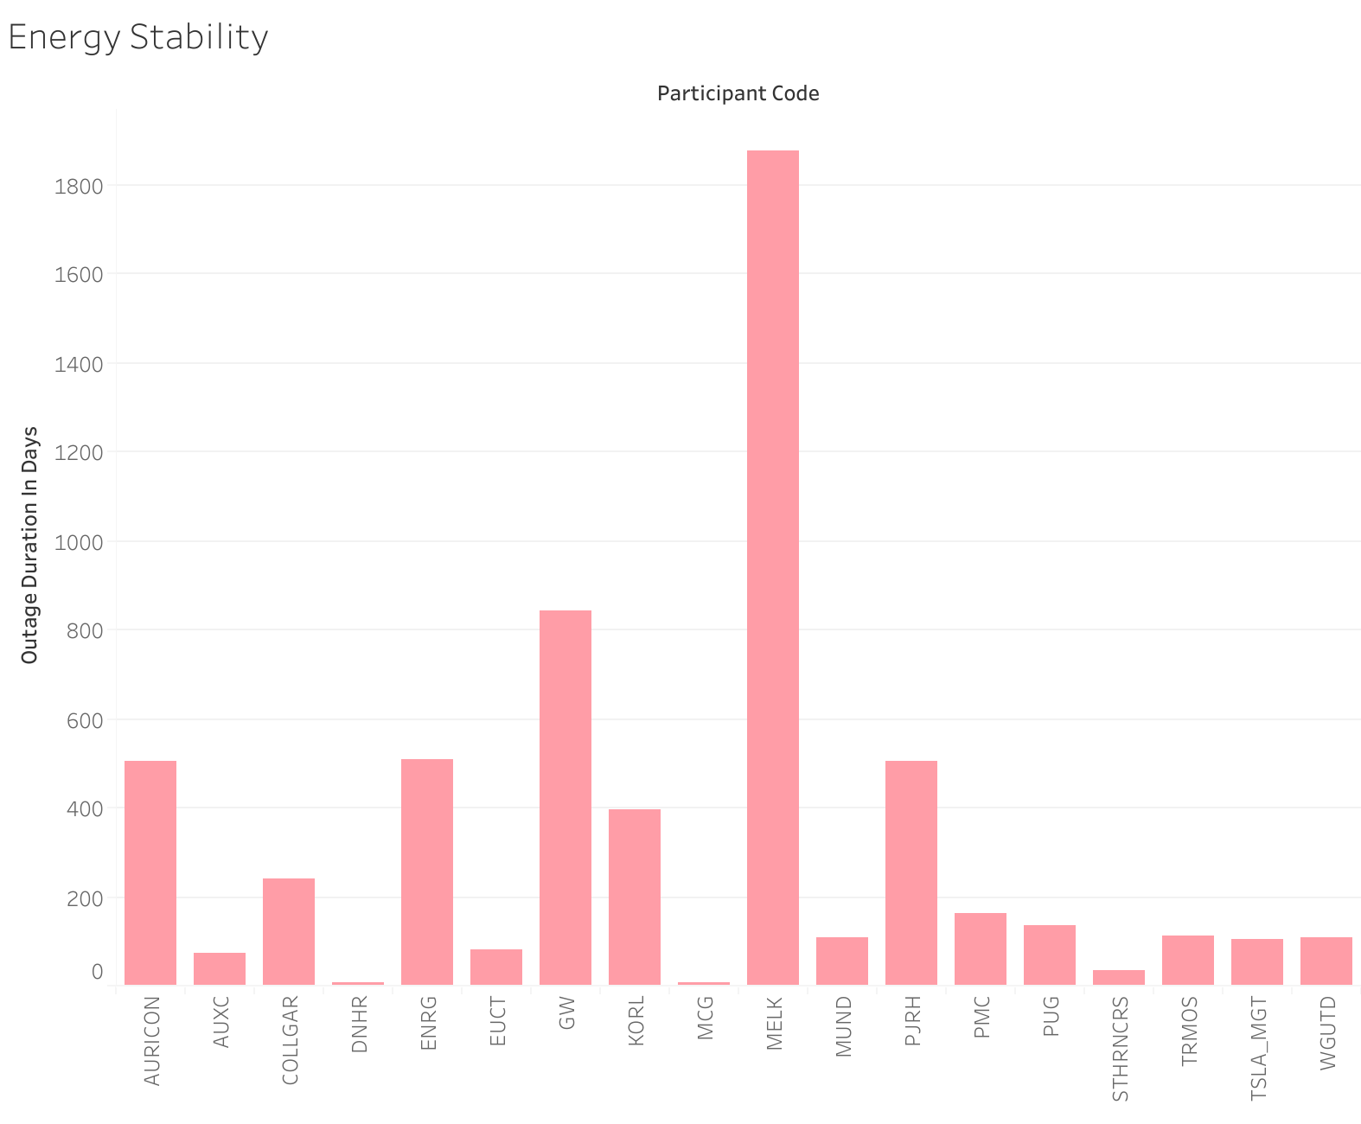
Upon completion of the SQL case study, I analyzed how MELK was responsible for the most outages resulting in a duration of 1,877 days of energy.

Slide 3
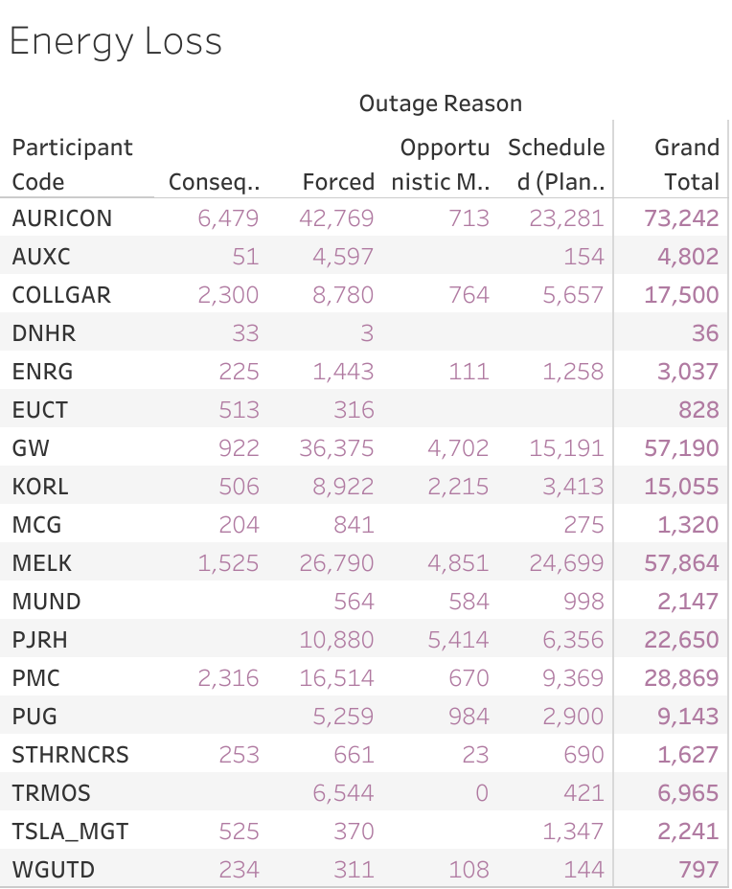

Slide 4
